Slide 1
E-Commerce Website
“Flexible customer-based Ecommerce website using DJANGO”
Guided by-Prof. Anupam Chowdhury

Slide 2
TABLE OF CONTENTS
01
Introduction
05
Flowchart
02
06
Abstract of Project
03
Problem statement
Our Team
04
Gannt chart
Outputs
07
06
Resources

Slide 3
E-Commerce Website
E-commerce has become one of the most popular methods of making money online and an attractive opportunity for investors. For those interested in buying an e-commerce business, this article serves to provide an introduction to e-commerce, covering the reasons for its popularity, the main distribution models and a comparison of the major e-commerce platforms available.

Slide 4
INTRODUCTION
An E-commerce website requires appropriate strategy of successful design and implementation. Everything is required to plan from scratch to end of website. The e-commerce sector is seen the exponential growth thus a new option will easily part of this regatta of commercial website. The e-commerce website will feature the online shopping facility of various fashion products under a single web space. The proposed web application will allow business personnel to make their total business using it and increase their reachability thousands of times more than today they have, over the internet. It will allow multiple shopping vendors to sale their products online. The product management in the system will be done in the form of categories. The safety of information is the main requirement of the system and will be handling according to that. To formulate this project first task is to do is cost estimation.

Slide 5
ABSTRACT OF PROJECT
In today’s fast-changing business environment, it’s extremely important to be able to respond to client needs in the most effective and timely manner. If your customers wish to see your business online and have instant access to your products or services.
Online Shopping is a lifestyle e-commerce web application, which retails various fashion and lifestyle products. This project allows viewing various products available enables registered users to purchase desired products. This is a project with the objective to develop a basic website where a consumer is provided with a shopping cart application and also to know about the technologies used to develop such an application. This document will discuss each of the underlying technologies to create and implement an e-commerce website

Slide 6
PROBLEM STATEMENT
Traditionally, customers are used to buying the products at the real, in otherwards, factual shops or supermarkets. It needs the customers to show up in the shops in person, and walk around different shopping shelves, and it also needs the owners of shops to stock, exhibit, and transfer the products required by customers. It takes labour, time and space to process these operations. Furthermore, the spread of the Covid-19 pandemic has caused a lot of changes in our lifestyle, people fearing to get outside their homes, transportation almost shut down and social distancing becoming all the more important. Big to small scale business that relied on the traditional incur a lot of consequence due to the lockdown issues. Some tend to more towards using social media platforms like Facebook to sell their product. However, the social media platforms have been beneficial for marketing purposes alone but leaves the whole task of customer and massive order management via direct messaging (DM), which takes a lot of time to respond to all customers.

Slide 7
—Binny Bansal and Sachin Bansal,
“We were not thinking about numbers then, but we knew something big can be built out of ecommerce.”

Slide 8
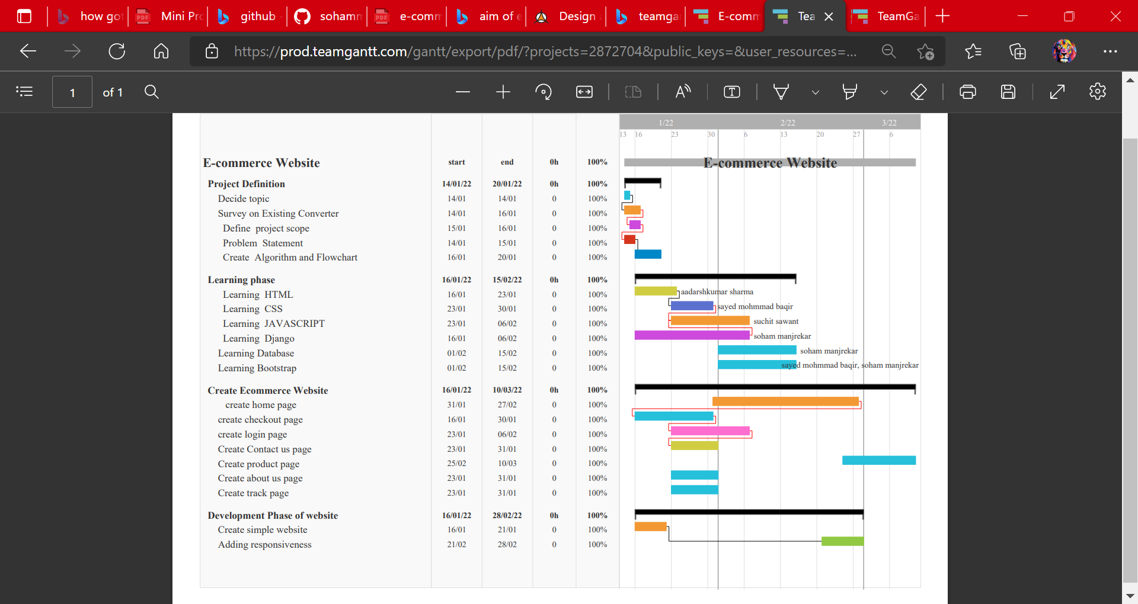
GANNT CHART

Slide 9
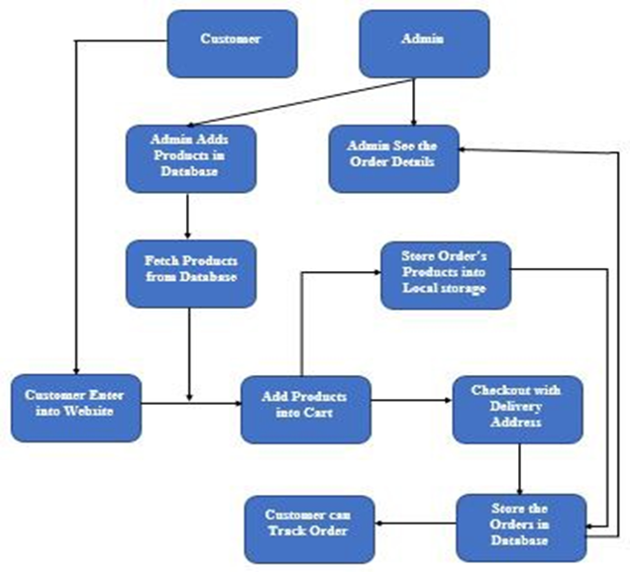
FLOWCHART

Slide 10
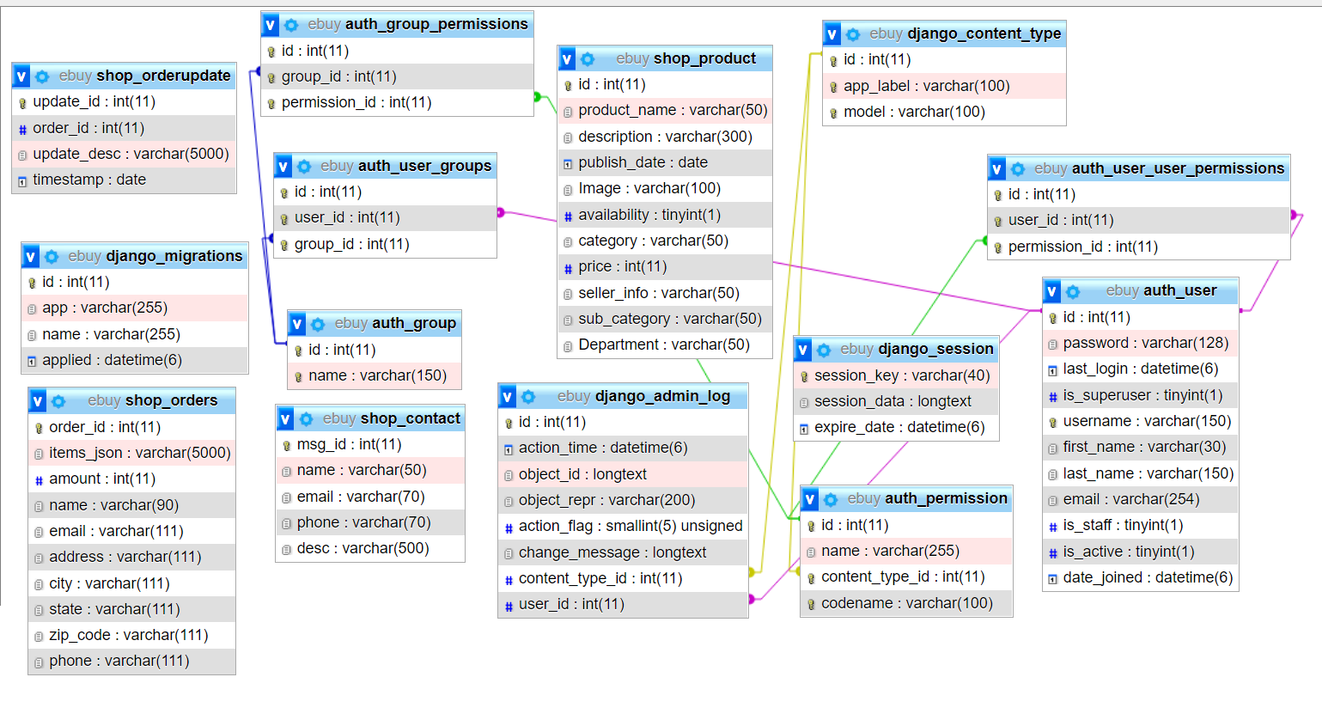
DATABASE STRUCTURE

Slide 11
SOFTWARE AND HARDWARE REQUIREMENTS
Operating System: Windows 7 and above
Language: Html, CSS, JavaScript, Django ,Bootstrap
Browser: Any browser and IE 8 and above.
Database Language: MySQL
Processor: A single-core 2GHz processor
RAM: 512 Mb and above

Slide 12
WEB PAGES DETAILS
STEP 2
STEP 1
STEP 3

Slide 13
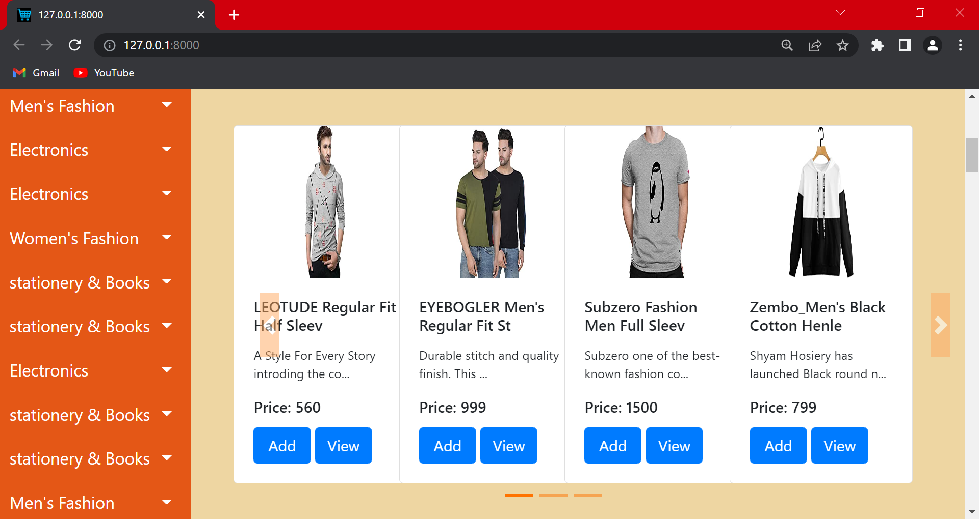
SHOP HOME PAGE

Slide 14
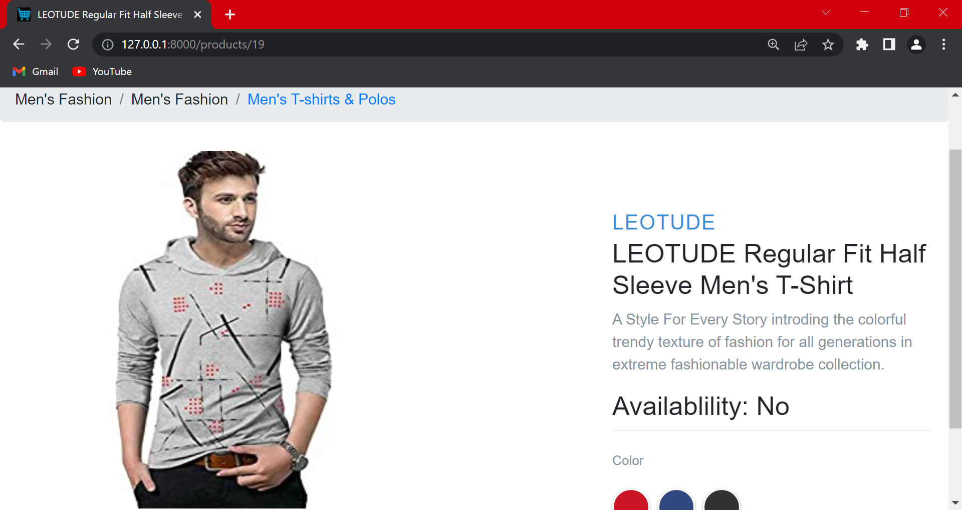
SHOP PRODUCT PAGE

Slide 15
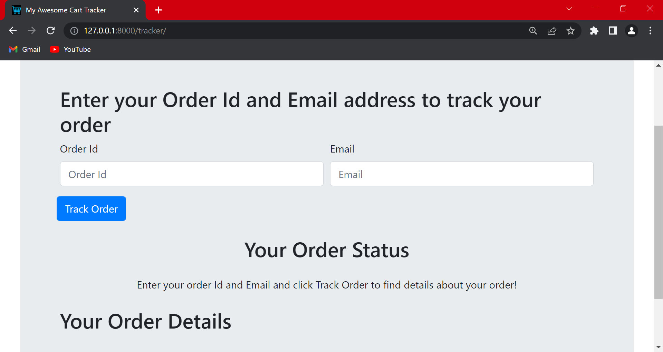
SHOP TRACK PAGE

Slide 16
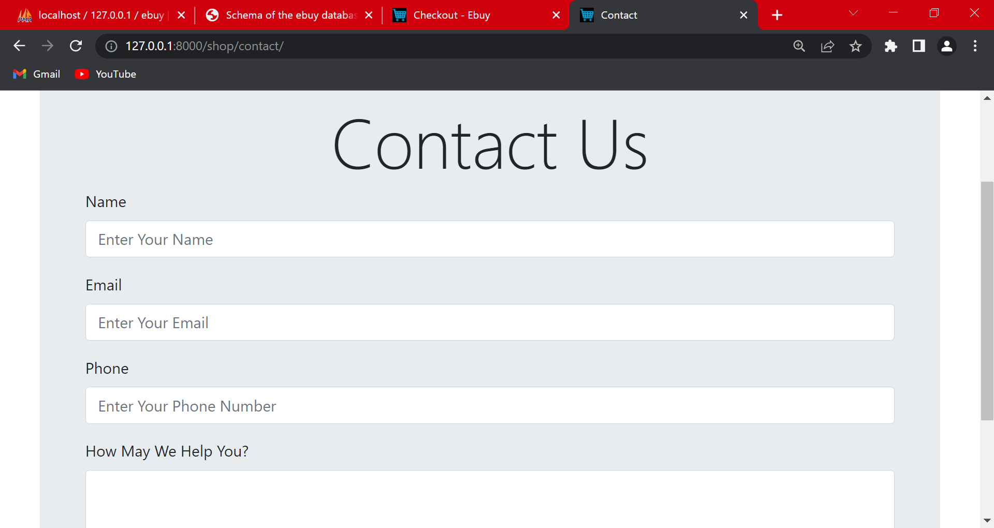
CONTACT US PAGE

Slide 17
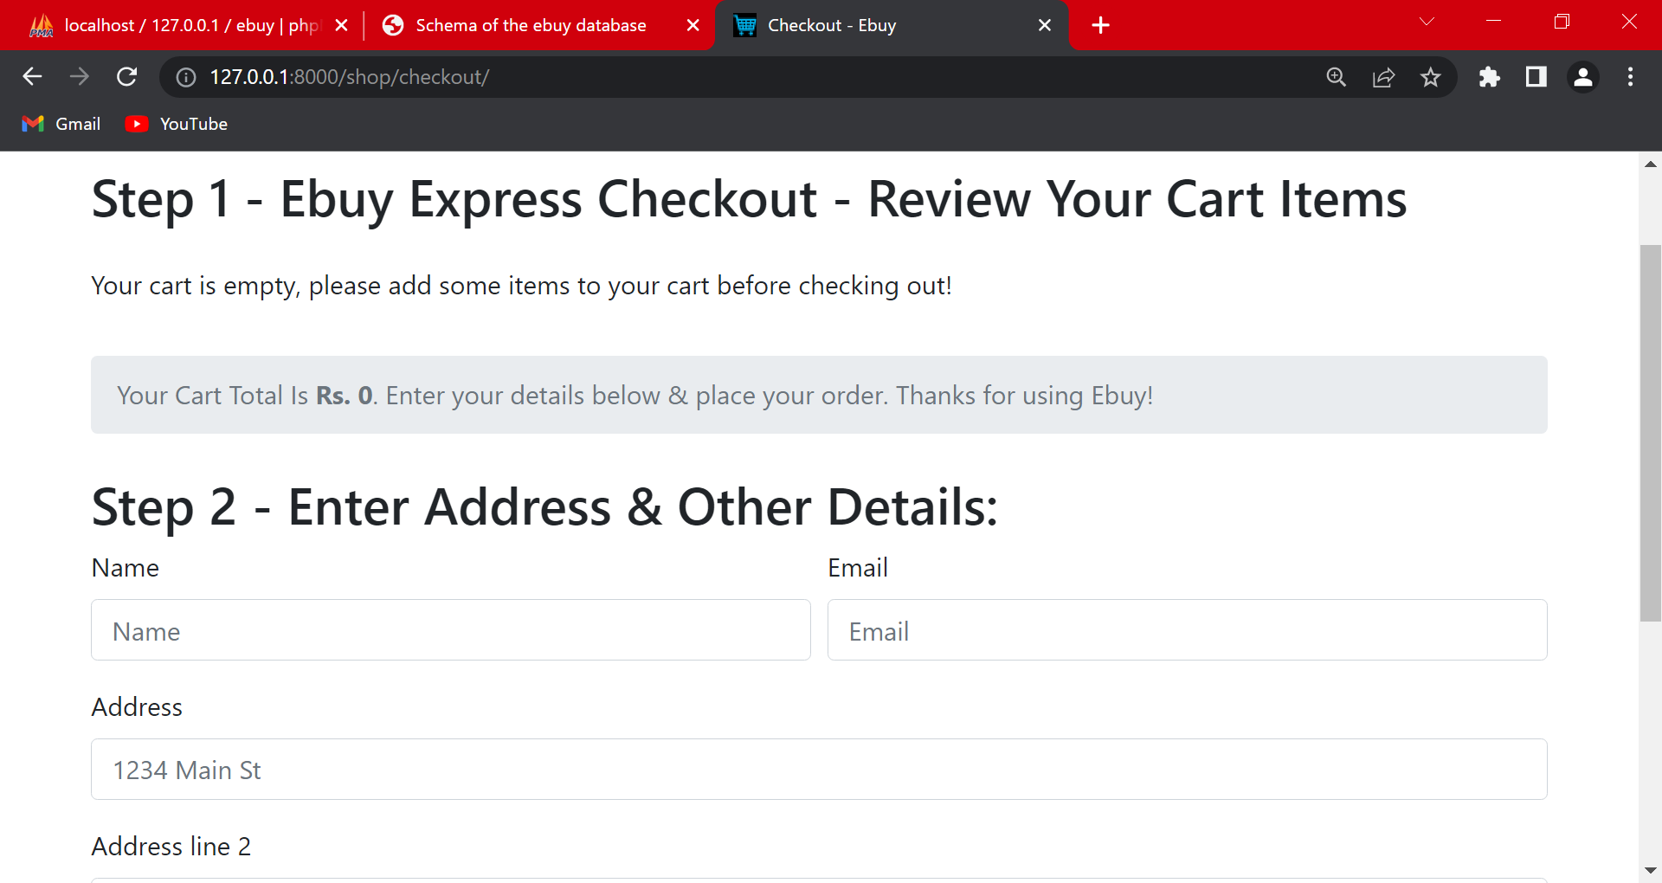
SHOP CHECKOUT PAGE

Slide 18
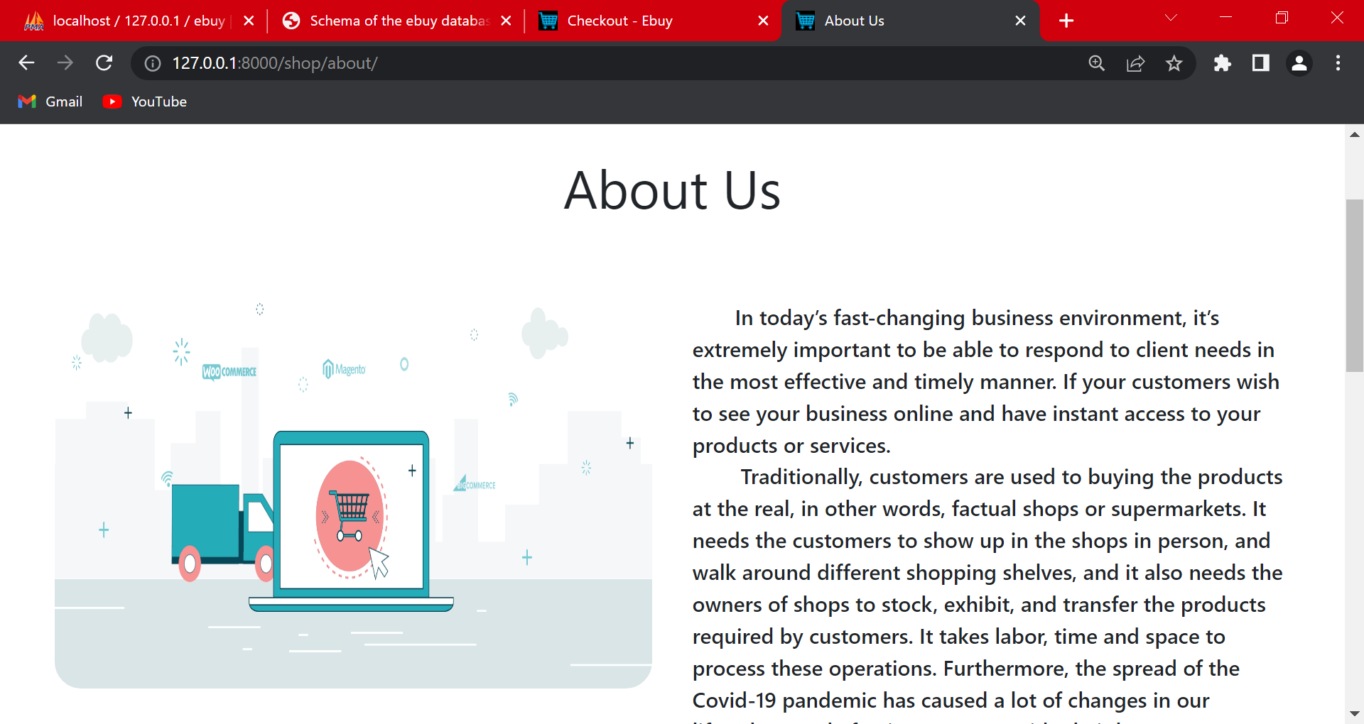
ABOUT US PAGE

Slide 19
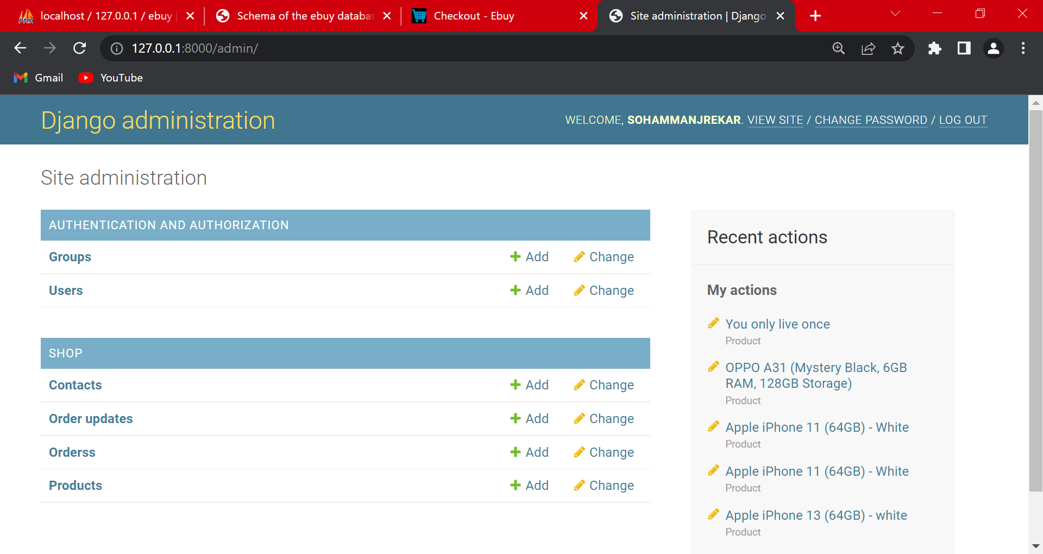
ADMIN PAGE

Slide 20
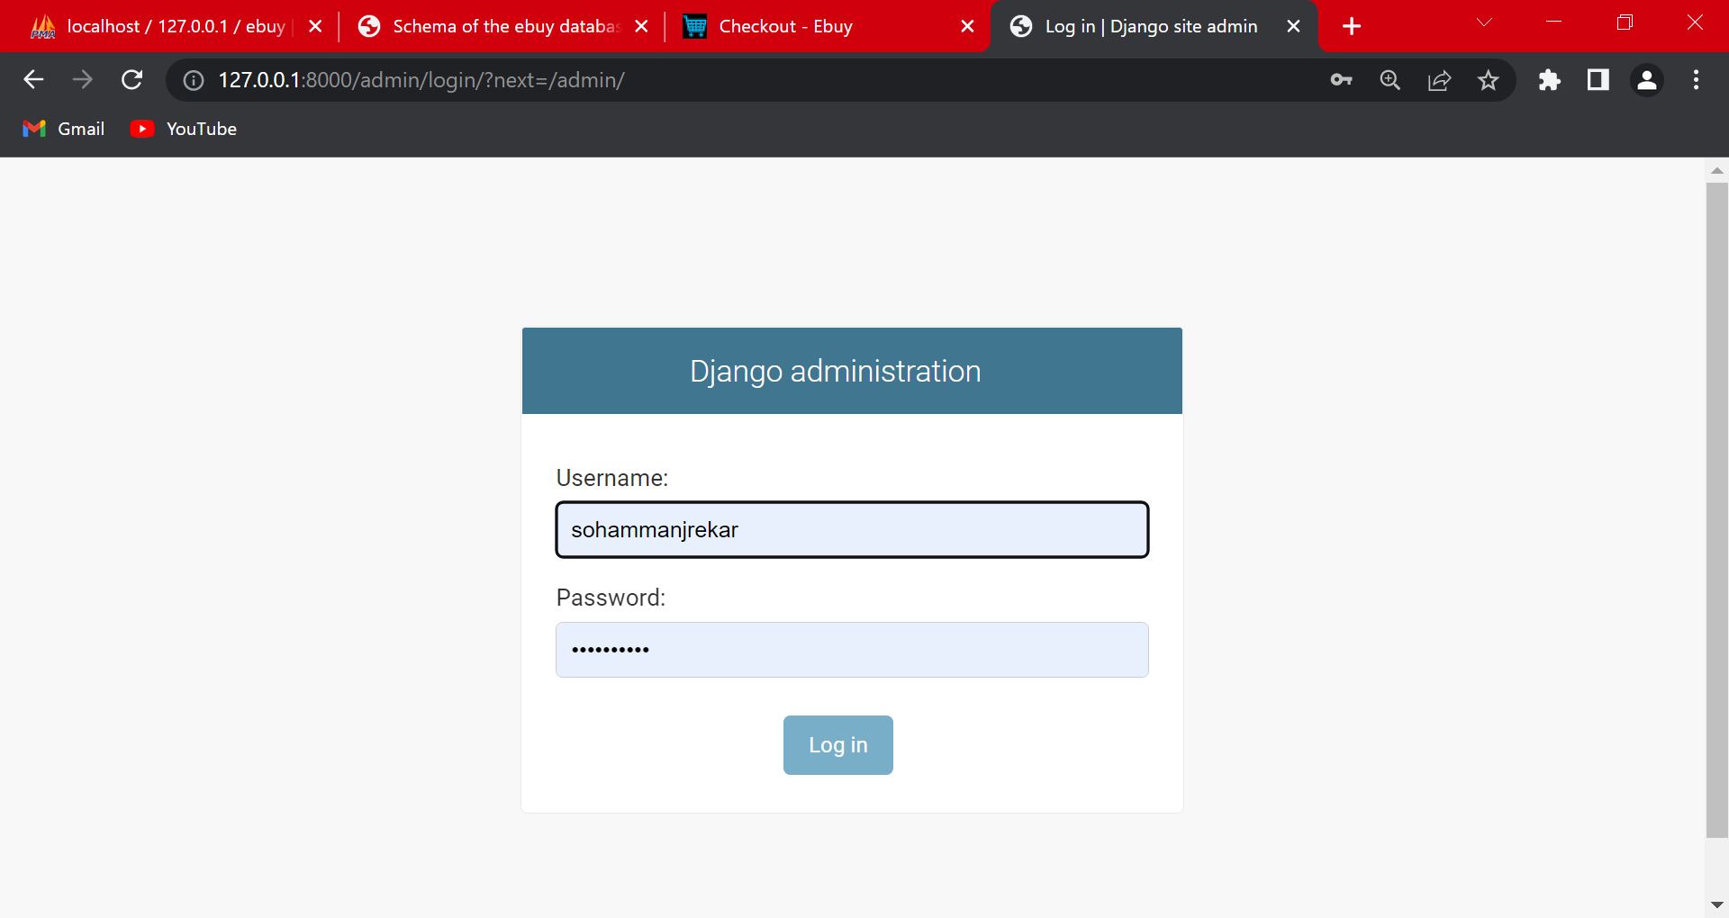
LOGIN Page

Slide 21
THE TEAM
Soham shrikant manjrekar
7045208474
sohammanjrekar@eng.edu.rizvi.in
Aadarshkumar Sharma
7081120277
aadarsh123@eng.rizvi.edu.in
Mohammed baquir sayed
88507737784
baquirsayed@eng.rizvi.edu.in
Suchit Sawant
7700990265
suchitsawant@eng.rizvi.edu.in

Slide 22
CONCLUSION
The project entitled ecommerce website system was completed successfully. The system has been developed with much care and free of errors and at the same time it is efficient and less time consuming. The purpose of this project was to develop a web application for purchasing items from a fashion shop. This project enabled me gain valuable information and practical knowledge on several topics like designing web pages using html & CSS, usage of responsive templates, designing of full stack Django application, and management of database using MySQL. The entire system is secured. Also, the project helped me understanding about the development phases of a project and software development life cycle. I learned how to test different features of a project.

Slide 23
REFERENCES
Python Documentation — https://docs.python.org/3/
Django Documentation — https://docs.djangoproject.com/en/3.0/
Git Documentation — https://git-scm.com/doc
Bootstrap —https://getbootstrap.com/

Slide 24
THANKS!
Does anyone have any question?
+91 7045208474 /9967863217
sohammanjrekar@eng.rizvi.edu.in
baquirsayed@eng.rizvi.edu.in
suchitsawant@eng.rizvi.edu.in

